Slide 1

Q-ICT ERP Default Template Web App

Slide 2
Table of Contents
Introduction
Project Overview
Project Architecture
Technologies Used
Flutter client-side front-end
Node.js server-side back-end
Azure Integration
Challenges & Solutions
Future Developments & Good to Have Features
Conclusion & Summary
Application Demonstration
Q&A Session
Notes:
Please hold your questions until the Q&A session

Slide 3
Introduction
Work placement project for NHL Stenden Emmen
30 ECs
Major: ICT & CT Information Technology Bachelor
Client-company: Q-ICT
Start date: 4 September 2023
90 days (8 hours per day)
Research phase + Development phase
Utilize SCRUM

Slide 4


Project Overview
Project objectives:
Default template ERP-like web application to approach potential customers
Made in Flutter and Node.js
Seamless integration with Microsoft Azure cloud platform
Project features:
Standardize login with two-step authentication utilizing TOTP (Time-based One Time Password) tokens
Default user, user role, and page route management
Standardize method for importing third-party API data
Secure approach for storing important information such as API keys
Predefined tables for data presentation that supports searching and sorting features
Responsive design

Slide 5
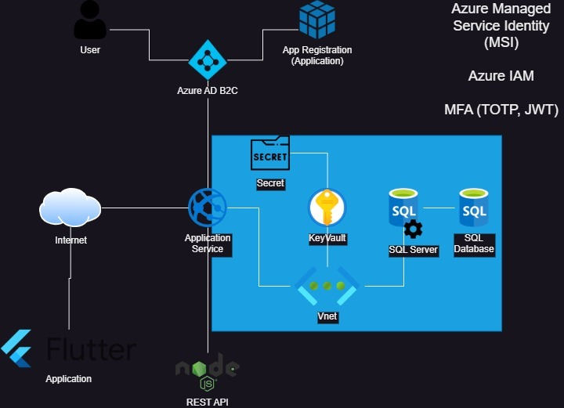
Project Architecture
Notes:
The entities in the blue rectangle are private to public and can only be accessed with the right authorization

Slide 6
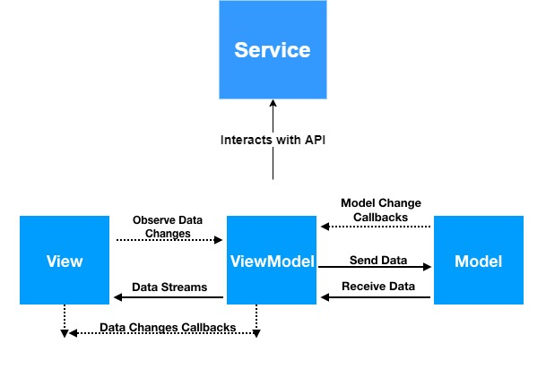
Project Architecture (Flutter web app)
Model—View—ViewModel architecture
Notes:
It is a form of design patterns
Model represents the data and business logic of the application
View represents the UI of the app
Responsible for displaying the data to the user and capturing user input
ViewModel acts as intermediary entity between Model and View
Contains presentation logic, transforming
Service files interact with the API

Slide 7
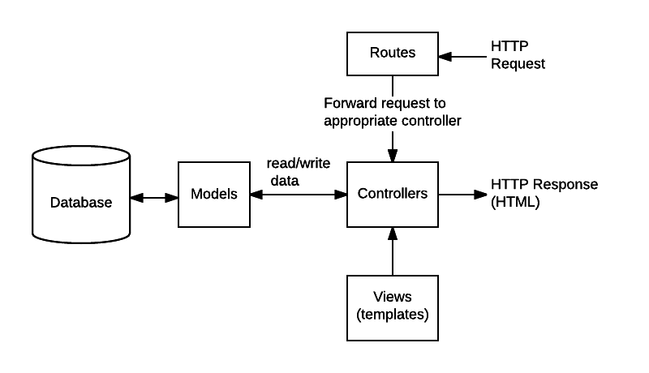
Project Architecture (Node.js API server)
Notes:
It pretty like MVC pattern.
Routes define the endpoints of the API and map them to a specific controller actions
The controllers acts as an intermediary between the model and the View.
The View is responsible for presenting the data to the web client in JSON response.

Slide 8
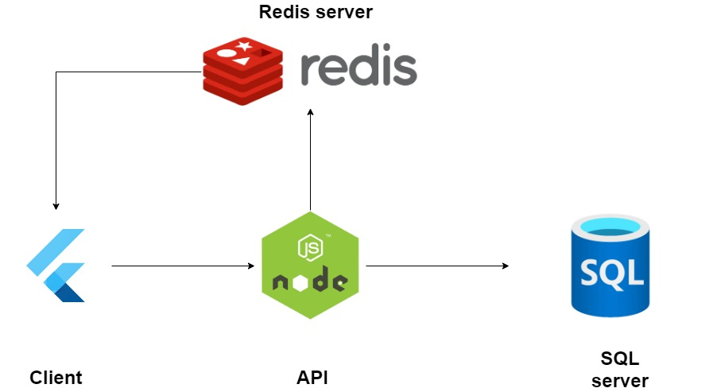
Project Architecture
Redis server integration
Notes:
It is a NoSQL in-memory database that stores data as a cache. It is designed for a high-performance data storage and retrievals. It stores data in the form of key-value pairs.
It is used within the application to make it retrieve the data faster.

Slide 9

Flutter client-side web app
Read data from the SQL database
Predefined table for data presentation along with filtering and sorting functionality
User role and page management
Log out user automatically based on inactivity
Create, edit, disable (soft-delete), delete users
Create, resume, pause, and delete Cron jobs
Import a new third-party API
Responsive design

Slide 10

Node.js Server-side API
Connector between the client and the database
Libraries:
Express
Passport-azure-ad
MSAL Node
Microsoft Graph client
Rate Limiter
Compression
Features:
Routing
Getting response from an API
Express sessions
Multi-threading & CPU process forking
Handle server shutdown gracefully

Slide 11
Node.js Server Authentication & Authorization
OpenID Connect identity layer (OAuth 2.0 protocol)
JWT Access & Refresh tokens
Sending OTP tokens through SMS and emails for phone & email validation
Validating OTP tokens
Notes:
It provides a standardized way to perform user authentication, as it leverages JWT for access and refresh tokens.

Slide 12

Azure Integration
Azure AD B2C Tenant
Is an IAM (Identity & Access Management) service
Used for having login authentication and authorization with MFA
OTP/TOTP
Open ID Connect
JWT -> access & refresh token

Slide 13

Azure Integration
Microsoft Graph REST API
Is a RESTful web API by Microsoft to interact with various Microsoft 365 services
Interacts with Azure AD tenant
User management (listing, creating, updating, disabling, deleting)
Refreshing access token

Slide 14

Azure Integration
Azure SQL server & database
Used for storing information/ API data
Company/ customer data
SnellStart data
OpenWeatherMap data

Slide 15

Azure Integration
Azure Key Vault
Creating secrets for securely storing sensitive information
Azure SQL database configurations (server host, username, password, database name)
Azure AD tenant credentials (tenant ID, client ID, tenant secret)
API keys (Snellstart, OpenWeatherMap)
Redis server configurations (hostname, password)

Slide 16

Challenges Encountered
Slight misunderstanding regarding Azure SQL server’s cost
Server session cannot be read by Flutter client
Lack of Microsoft documentation regarding Node.js and Azure AD
Notes:
Resulting into excessive cost of Azure service, exceeding the budget

Slide 17

Future Development
Integration with Microsoft Power Automate
Trigger workflows such as notifications, alerts based on user actions
Automated streamline data synchronization
Better and proper unit testing for both the server and client
Integration with Azure Cache for Redis
Notes:
Alerts to admins when certain events occur in the application. This could be based on user interactions that will send alerts to emails or Teams messages
Sync data between Flutter client, Node.js server, and other Microsoft services. For example, a flow update to Azure SQL database records when a new data is added through the Flutter app.

Slide 18

In Conclusion
Azure RDBMS is a solid SQL database
Support traditional relational database features such as indexes, stored procedures, backups, patching, and monitoring
Using Azure AD tenant is a solid way to implement MFA with Microsoft Authenticator
Flutter and Node.js server makes a weird combination with Azure AD
Sessions do not work
Lack of official Microsoft documentation
Notes:
SQL databases are recommended for web apps requiring well-structured relational data that is easy to scale vertically. SQL database allows for complex transactions and relationships between different tables. SQL has a fixed schema, so the structure of the data needs to be defined in advance.
NoSQL can scale horizontally because they can handle large volumes of data with ease, faster than SQL. It has dynamic schema, allowing more flexibility in handling a diverse data structures.

Slide 19


Slide 20

Questions?

Slide 21

Thank you for your attention!

